Slide 1

Consulting and Business Management Firm

Slide 2


Mission: To justify that "The whole world is one single family"
Vision: We are only solution provider for every problem of our stakeholder Just as: Every door has got its own Key.
Branding Name : Krishna Prema Consultancy-KPC
Corporate Name : KRISPCONS PVT LTD

Slide 3
What is KPC ?
Krishna Prema Consulting (KPC) is a performance management-consulting firm focused on helping customers creates methodical and predictable ways to improve business results and performance, across the organization.
We help clients to grow their sales, increase profits and reduce expenses by making possible more informed, proactive decision-making and positive organizational change. With experience gained from hundreds of client engagements, KPC realizes this goal through proven strategic consulting services.
.

Slide 4
How we deals with Project ?
1. Project Approach
2. Project Strategy
3. Analysis, Design and Construction
4. Integration Testing
5. Implementation Methodology
6. Production Deployment
7. Production Roll out

Slide 5
1.Project Approach
We utilizes a formal project management methodology called KPC Project Portfolio Management.
We feel our methodology delivers a competitive advantage to our customers by insuring a repeatable proven process for successful business intelligence and performance management solutions delivery.

Slide 6
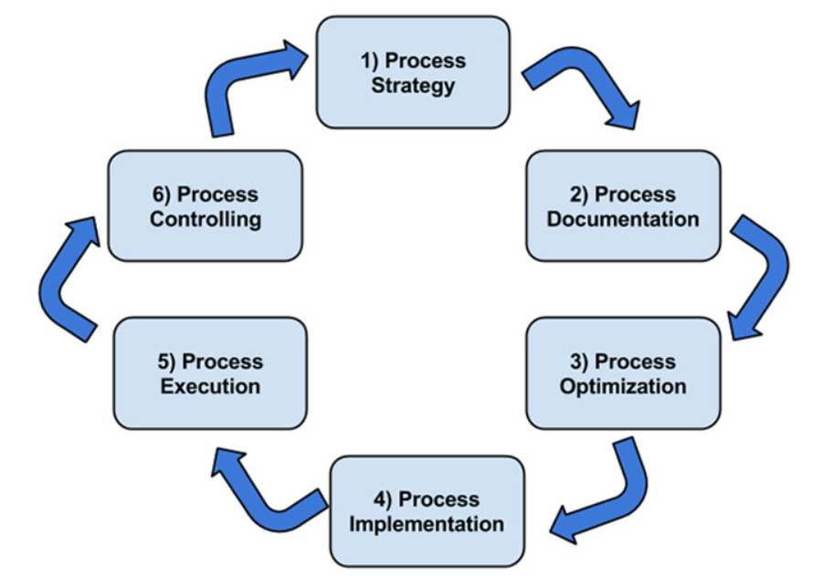
2. Project Strategy
The major phases of the KPC Implementation is defined in the below methodology.

Slide 7
3. Analysis, Design, and Construction
This is a set of parallel processes to accomplish the design and development of the actual Business Intelligence and Technical and Technical Infrastructure components.
These maps to our clients' User Requirements, Functional Specifications, Design Specifications, System Build and Configuration, IQ, Unit Tests, and Trace ability Matrix.

Slide 8
4. KPC Implementation Methodology
When our customers do not require a specific methodology, KPC’s utilizes a formal project management methodology called KPC Implementation Methodology.
We feel our KPC methodology delivers a competitive advantage to our customers by insuring a repeatable proven process for successful business intelligence and performance management solutions delivery.

Slide 9
5. Integration Testing
This phase identifies the end-to-end testing of the overall Business Intelligence solution.
This maps to our clients System Test, Integration Tests and Operational Quality.

Slide 10
6. Production Deployment
This phase identifies the pre-roll out testing that occurs on the Production platform.
This maps to our clients Production Quality or User Acceptance Testing (UAT).

Slide 11
7. Production Roll out
This is the actual effort involved to deliver the BI solution to the end users.
This maps to our clients' Technical Knowledge Transfer, End User Training, Transition Plan, Support Plan, and Release to Production.

Slide 12
What is KPC management consulting services?
KPC management consulting services focus on our clients' most critical issues and opportunities: strategy, marketing, organization, operations, technology, transformation, digital, advanced analytics, corporate finance, mergers acquisitions and sustainability across all industries and geographies.
We bring deep, functional expertise but are known for our holistic perspective.
We capture value across boundaries and between the silos of any organization. We have proven a multiplier effect from optimizing the sum of the parts, not just the individual pieces.

Slide 13
Our 4 Key
KPC will offer clients world-class consulting services in four key verticals:
1. Iinformation security and risk management,
2. Engineering Consulting
3. Business Continuity Management
4. Business Process Management

Slide 14
Engineering Consulting
We provide consultancy services to multiple sectors, helping our clients increase productivity and, as a result, profitability.
Our team of design engineers, environmental engineers, construction engineers and project managers come with the requisite experience, technological understanding and skill to execute a diverse range of projects for our clients worldwide.

Slide 15
Information Security Management Services
Protecting data is a top management priority in the information age, and to this end, KPC provides information security strategies that are tailor-made to protect data important to our customers - and their customers.
From collection to storage, our processes ensure that data is kept safe at every stage, ensuring a competitive advantage for our clients in any market.

Slide 16
Business Continuity Management
Harnessing the power of technology, our Business Continuity Management solutions ensure that the IT infrastructure, people and operations of any organization operate within an effective continuity framework.
We assess probable risks to provide uninterrupted operations, providing our clients with a distinctive edge over their competition.

Slide 17
Business Process Management Services
The objectives of our Business Process Management services are to optimize cost and gain efficiency in processes, thereby enabling our clients to focus on their core business activities.
Engaging with KPC Business Solutions, our clients enjoy a two-fold advantage of identifying leads to maximize opportunities and to co-create new possibilities.

Slide 18
Our Value :
(1) Kind to everyone, (2) Does not quarrel with anyone (3) Fixed in the Absolute Truth, (4) Equal to everyone, (5) Faultless (6) Charitable, (7) Mild, (8) Clean, (9) Simple, (10) Benevolent, (11) Peaceful, (12) Completely attached to KPC, (13) Has no material hankering (14) Meek, (15) Steady, (16) Self-controlled, (17) Sane, (18) Respectful, (19) Humble, (20) Grave, (21) Compassionate, (22) Friendly, (23) Poetic, (24) Expert, (27) Silent.

Slide 19
Thank you

